Slide 1
Time Table Management System
Project By:Divij Pirankar 03
Shreya Gavli 10
Aman Singh 01

Slide 2
Introduction
The effective management of timetables is crucial for ensuring smooth operations and optimal utilization of resources. So,we have developed the Time Table Management System, a comprehensive and user-friendly solution designed to streamline the process of creating, updating, and managing timetables with ease and efficiency.This can be used by the Admin Faculty and the Students and will help them to efficiently manage the time table as they need.

Slide 3
Software Tools Used
VS code
GitHub
Jenkins
Sonarlint ,Sonar Cloud

Slide 4
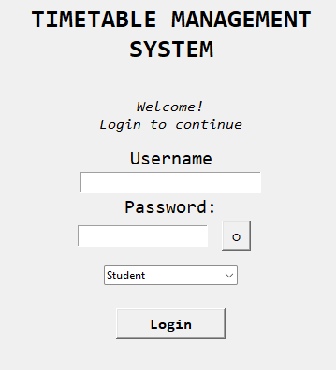
Overview of the features of the Time Table Management System
The User can log in as Admin,Student and Faculty.

Slide 5
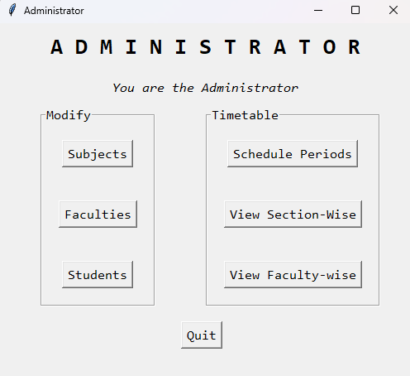
Overview of the features of the Time Table Management System
So if the user Logins as Admin then he will get this interface

Slide 6
The Admin Can Modify Subject,Faculty ,Student he can Also Schedule periods,View Section Wise and View Faculty Wise according to how he wants.
Modify Subjects:
The admin has the authority to add, update, or delete subjects in the system.
They can specify details such as subject code, name, type (theory or practical), and other relevant information.
Modify Faculty:
The admin can manage faculty information by adding new faculty members, updating existing profiles, or Delete faculty who are no longer active.
Details such as faculty ID, name, contact information, and assigned subjects can be modified as needed.
Faculty profiles are linked to the timetable scheduling module, allowing seamless allocation of teaching responsibilities.

Slide 7
3. Modify Students:
Admins have the capability to manage student data, They can add new students, students,manage their password details ,update existing records, or remove who have graduated or left the institution.
Student information is essential for creating class schedules and ensuring proper allocation of resources.
4. Schedule Periods:
Admins can create and manage the overall timetable structure by scheduling periods for each day of the week by using the faculty name,paper code and period
They can define parameters such as the number of days, periods per day, and any other scheduling constraints.
The scheduling module provides a user-friendly interface for organizing and visualizing the timetable grid.

Slide 8
5.View Section-wise Timetable:
The admin can generate section-wise timetables to view the class schedules for specific groups of students.
Timetables can be customized to display information such as subject names, faculty, classroom locations, and other relevant details.
6.View Faculty-wise Timetable:
Admins have the ability to view timetables for individual faculty members, allowing them to see their teaching assignments and availability.

Slide 9
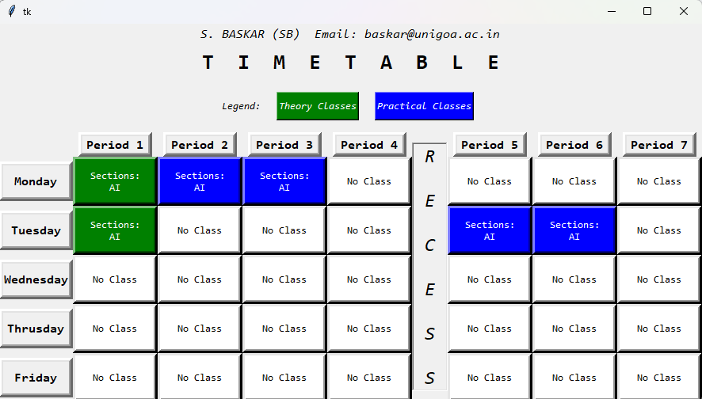
If the User Logins As Faculty then it will be followed by the interface shown below:

Slide 10
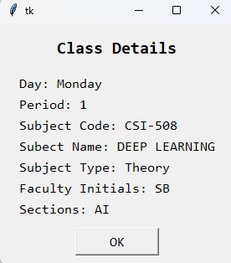
So the faculty will also be able to view after clicking the button of particular day of the week

Slide 11
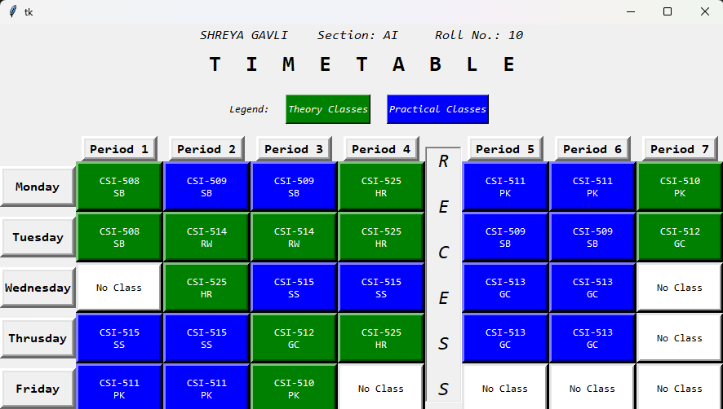
If the User Logins As Student then it will be followed by the interface shown below:

Slide 12
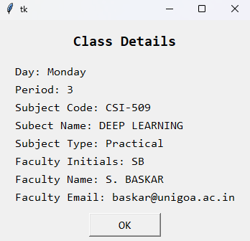
So the Student will also be able to view after clicking the button of particular subject the details shown below:

Slide 13
Conclusion
The Time Table Management System serves as a valuable tool for educational administrators, faculty members, and students alike, fostering efficiency, transparency, and success within the academic community. Through continuous refinement and adaptation, the system contributes to the ongoing improvement of educational processes and outcomes.

